Slide 1


FIFA Player Information Management System
ERG 3010 Group 10 – Division Subgroup
Wenjing CAI 116010004
Yifan LAN 116010103
Zhihao XU 117010330
Erdi GAO 117010066
Yilei TU 117010251

Slide 2
1 Introduction
FIFA: International Football Association & Video Game
~18000 Players; 600+ Clubs
Football Player Information Demonstration & Management

Slide 3
2 Labor Division
Name | Student ID | Task Assignment
Wenjing CAI 蔡文婧 | 116010004 | Front-end Web Interface Design; Front- and Back-end Frame Construction
Yifan LAN 兰一帆 | 116010103 | Web Application by Flask; Back-end Functions Implementation; Front- and Back-end Frame Construction
Erdi GAO 高尔笛 | 117010066 | Web Application by Flask; Back-end Functions Implementation; Front-end Web Interface Design
Zhihao XU 徐志豪 | 117010330 | Data Collection and Preprocessing; Database Construction; Front-end Web Interface Design
Yilei TU 涂毅磊 | 117010251 | Schema Design; Data Analysis and Visualization; Machine Learning Implementation; PPT Preparation

Slide 4
3 Motivation & Goals
Integrate FIFA player information
Build well-informed database and beautiful display interface
Recommend similar players; Predict positions;
Better participate in online and offline football matches

Slide 5
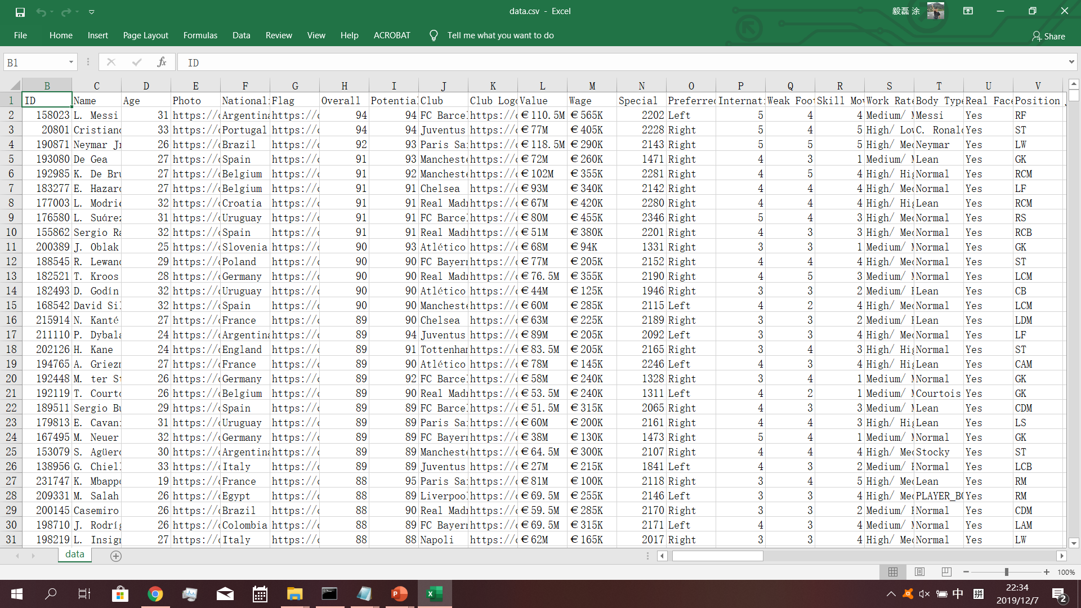
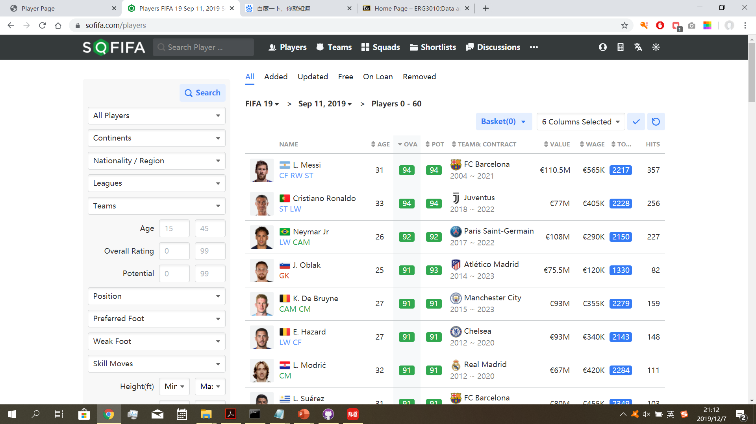
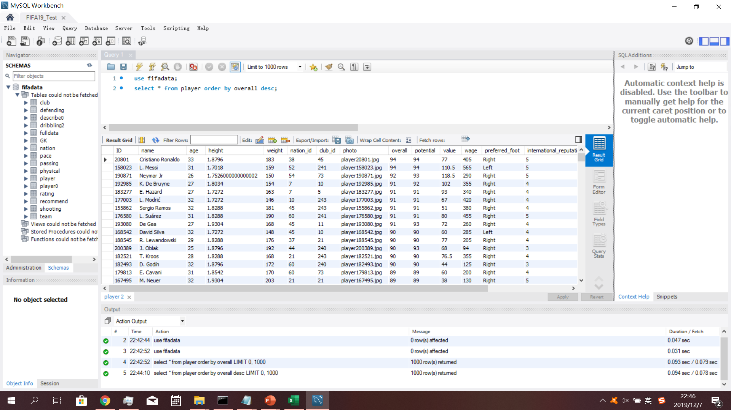
4 Materials & Data Source
Our data are crawled from https://sofifa.com/, which is a professional FIFA information website.

Slide 6
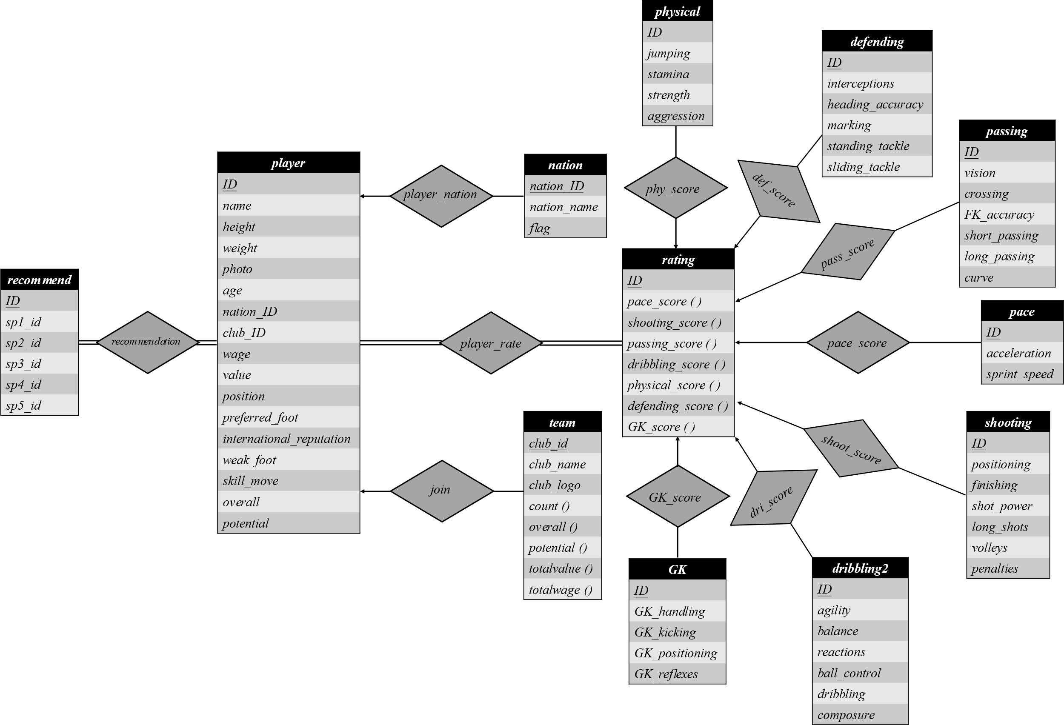
5 Database Schema

Slide 7
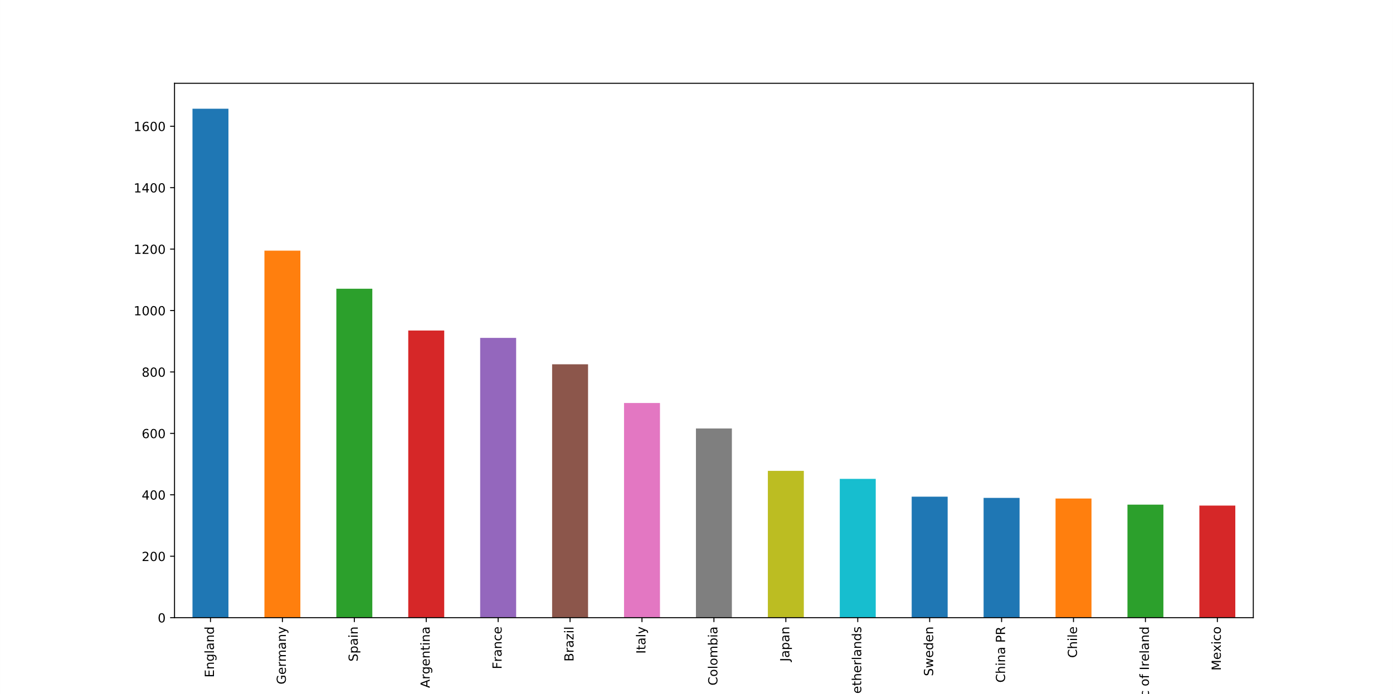
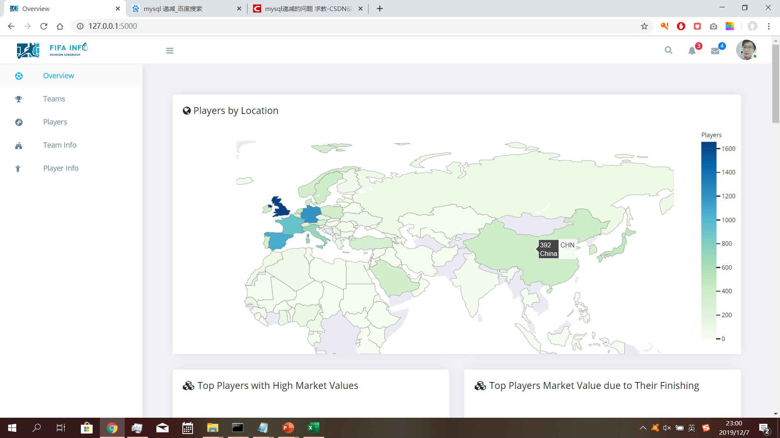
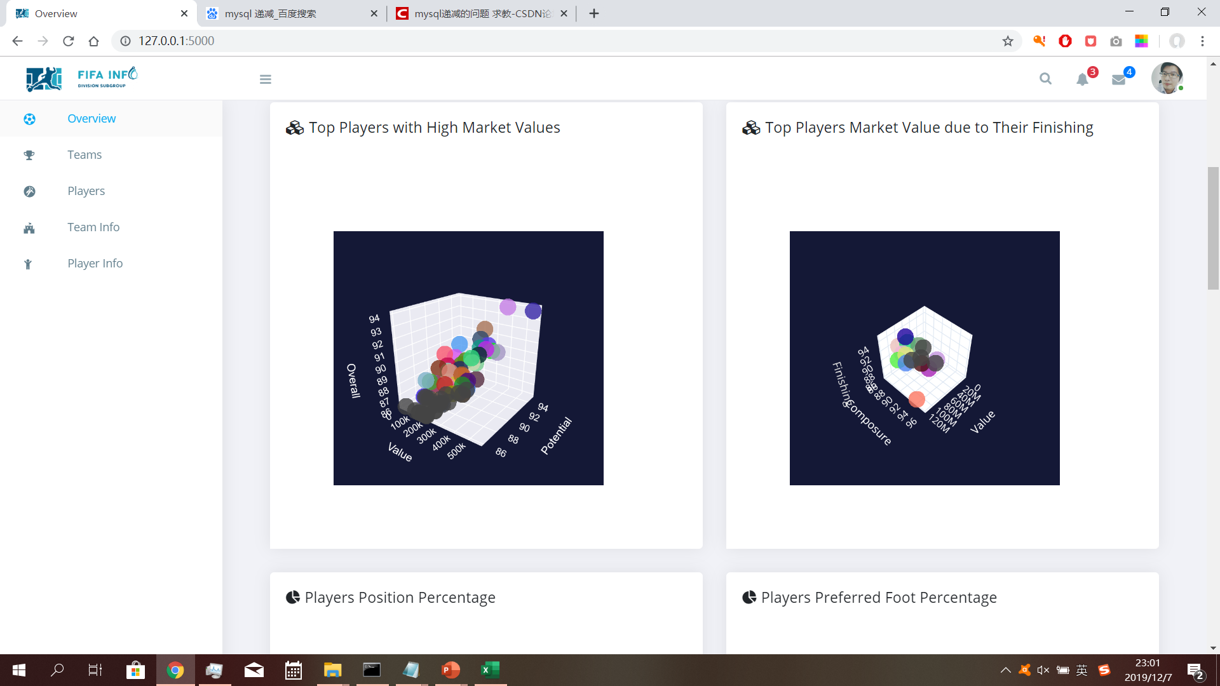
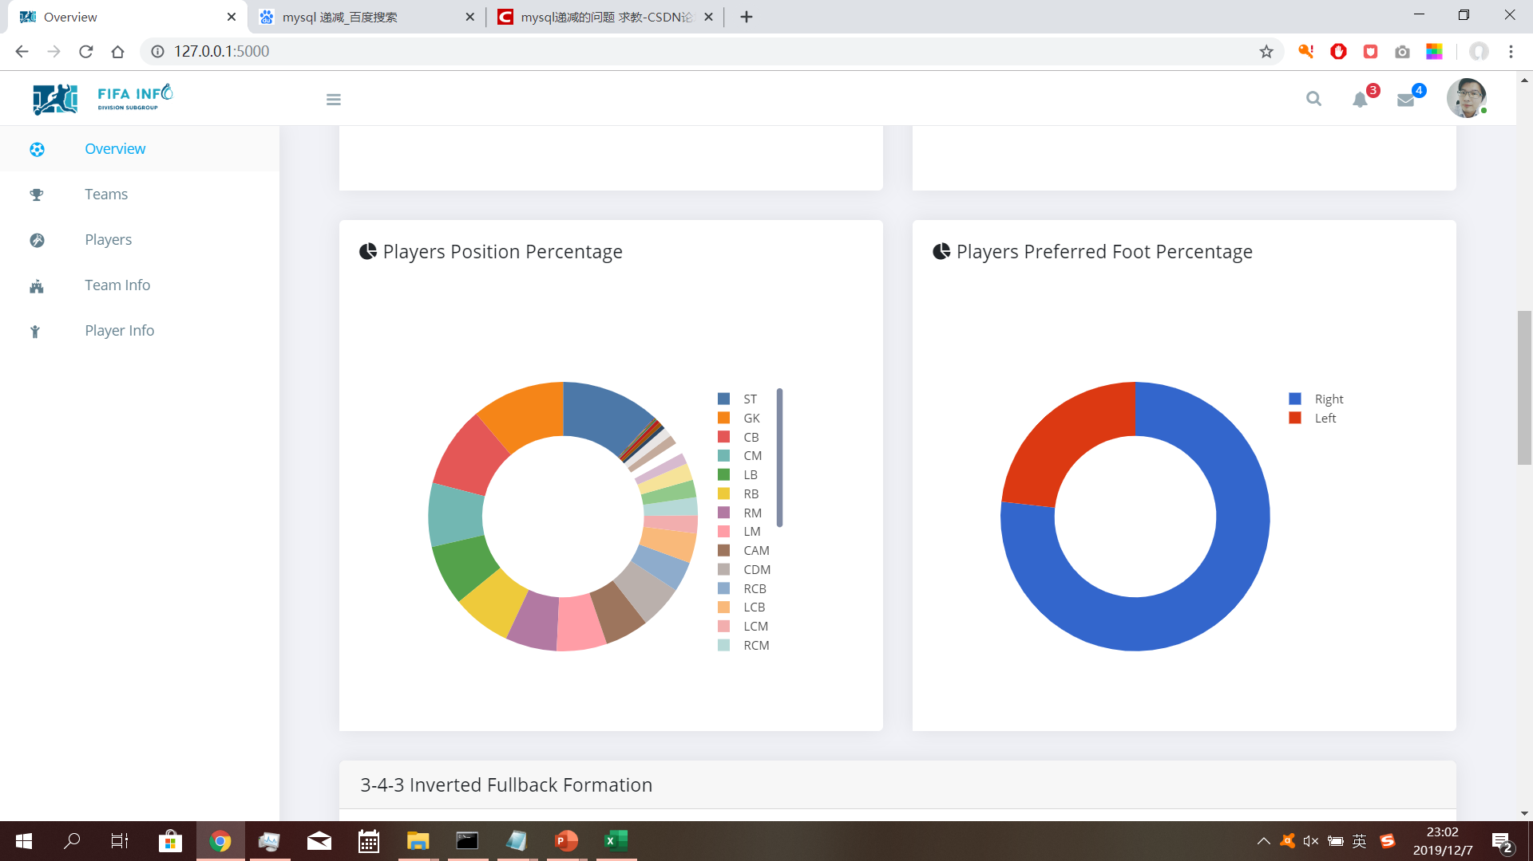
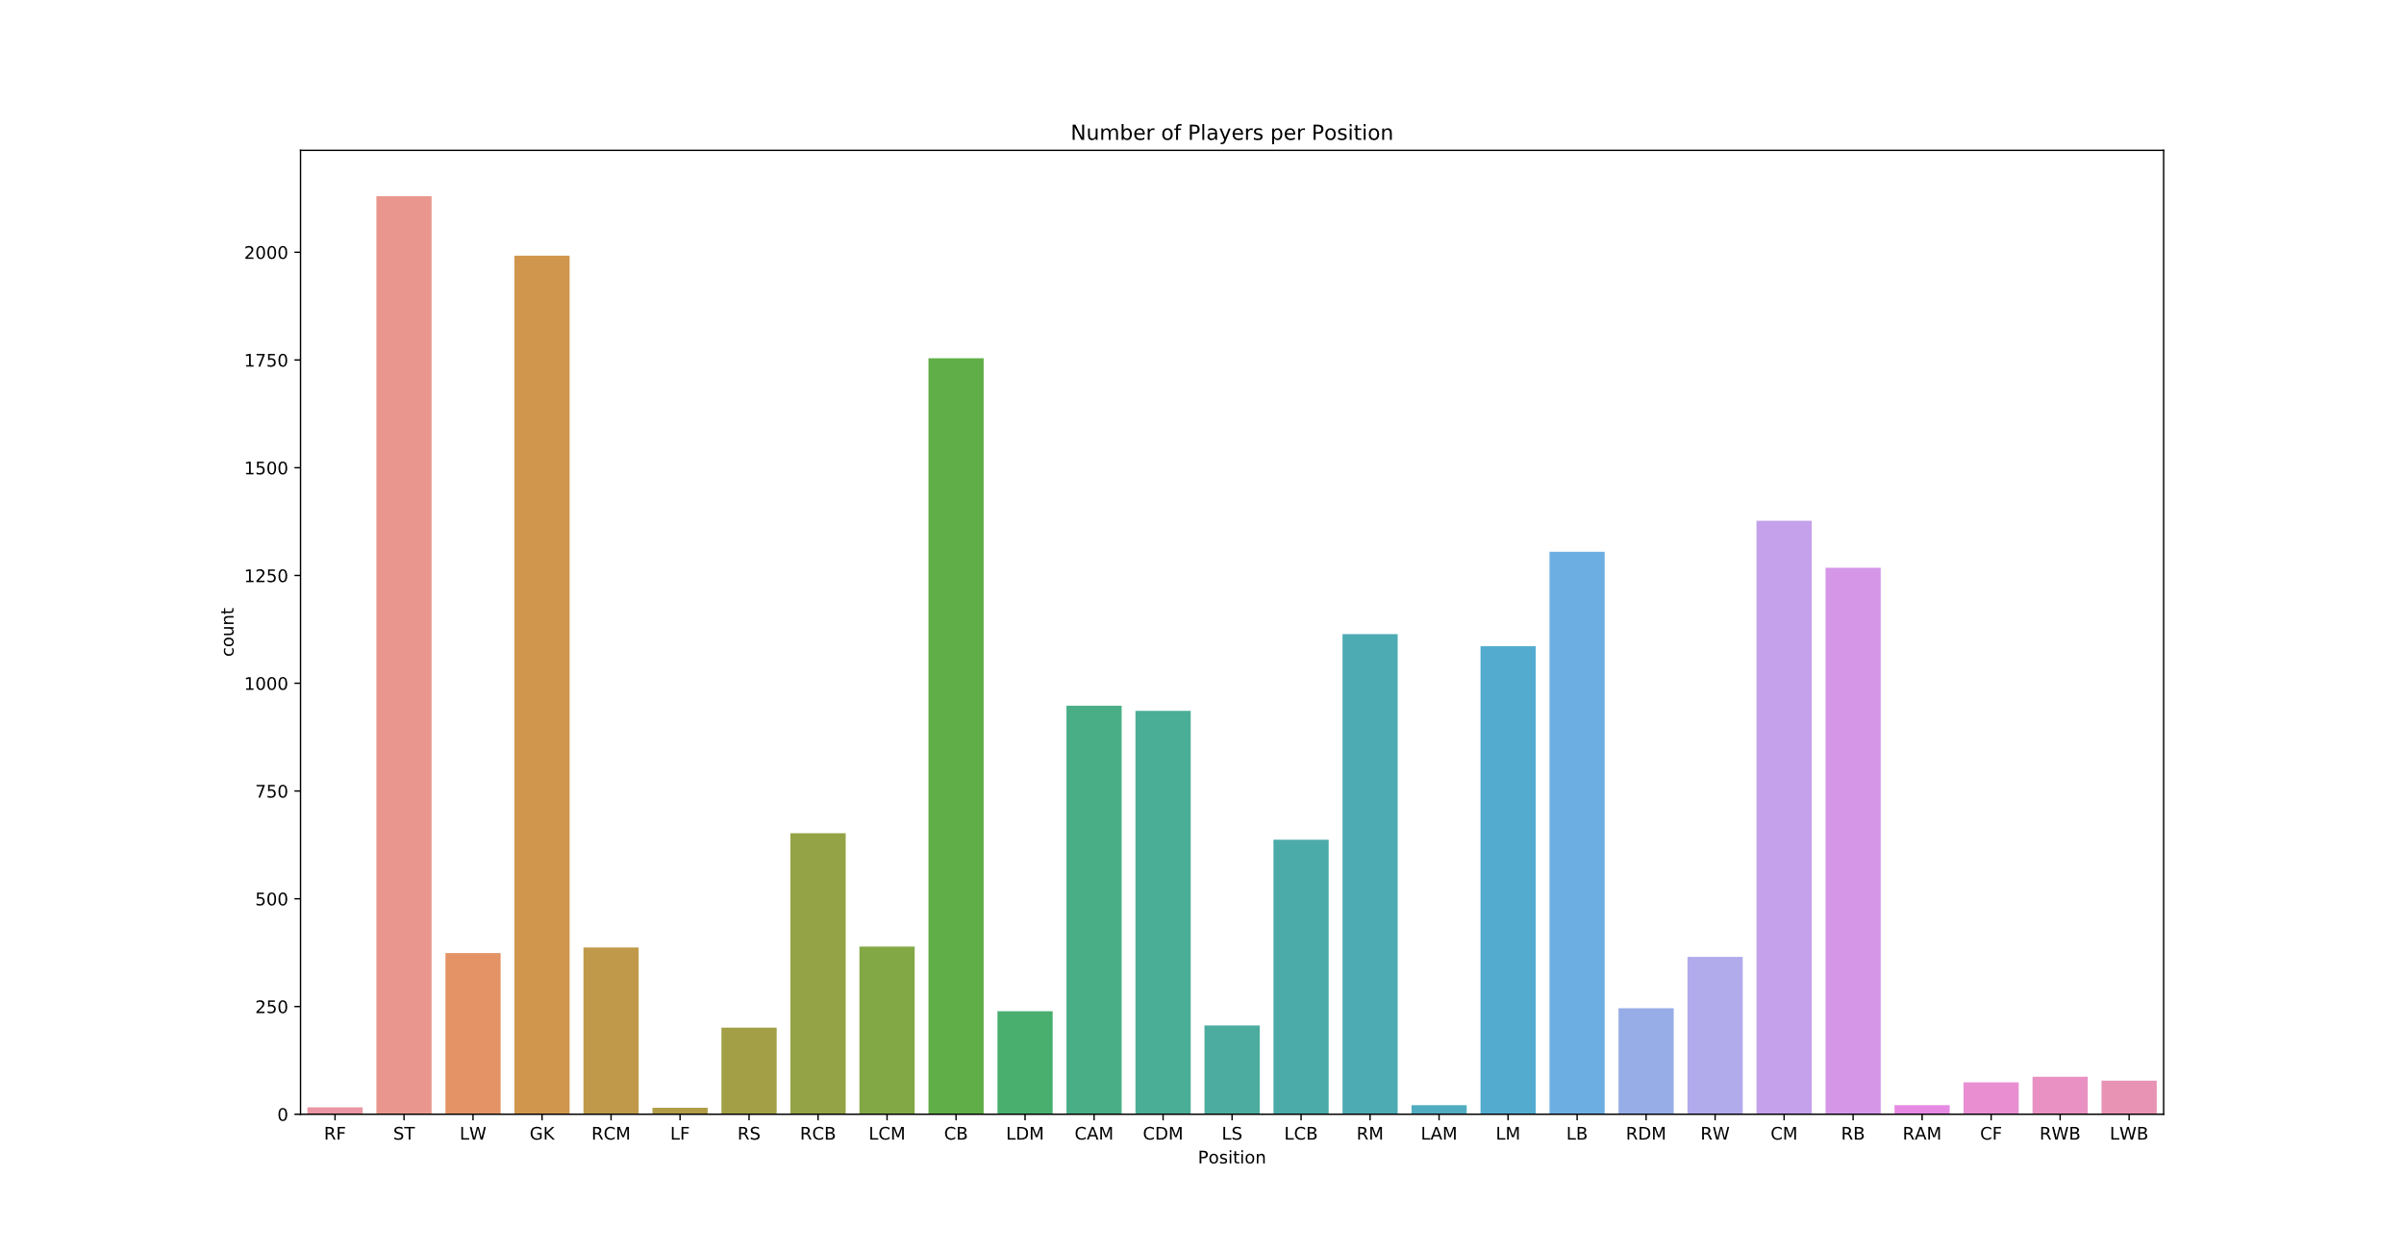
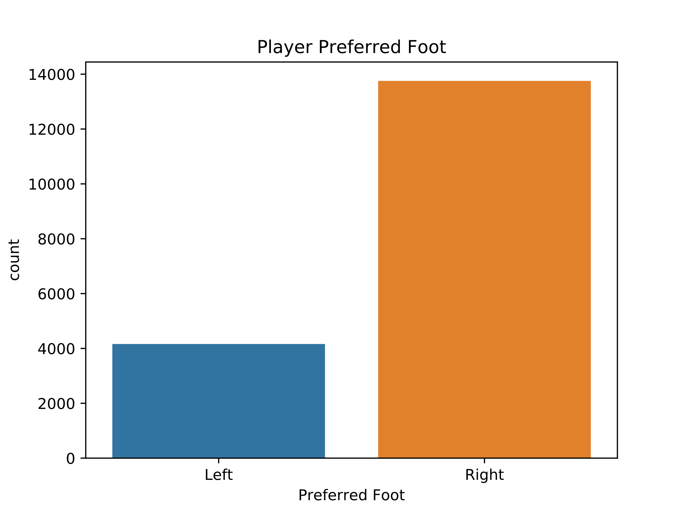
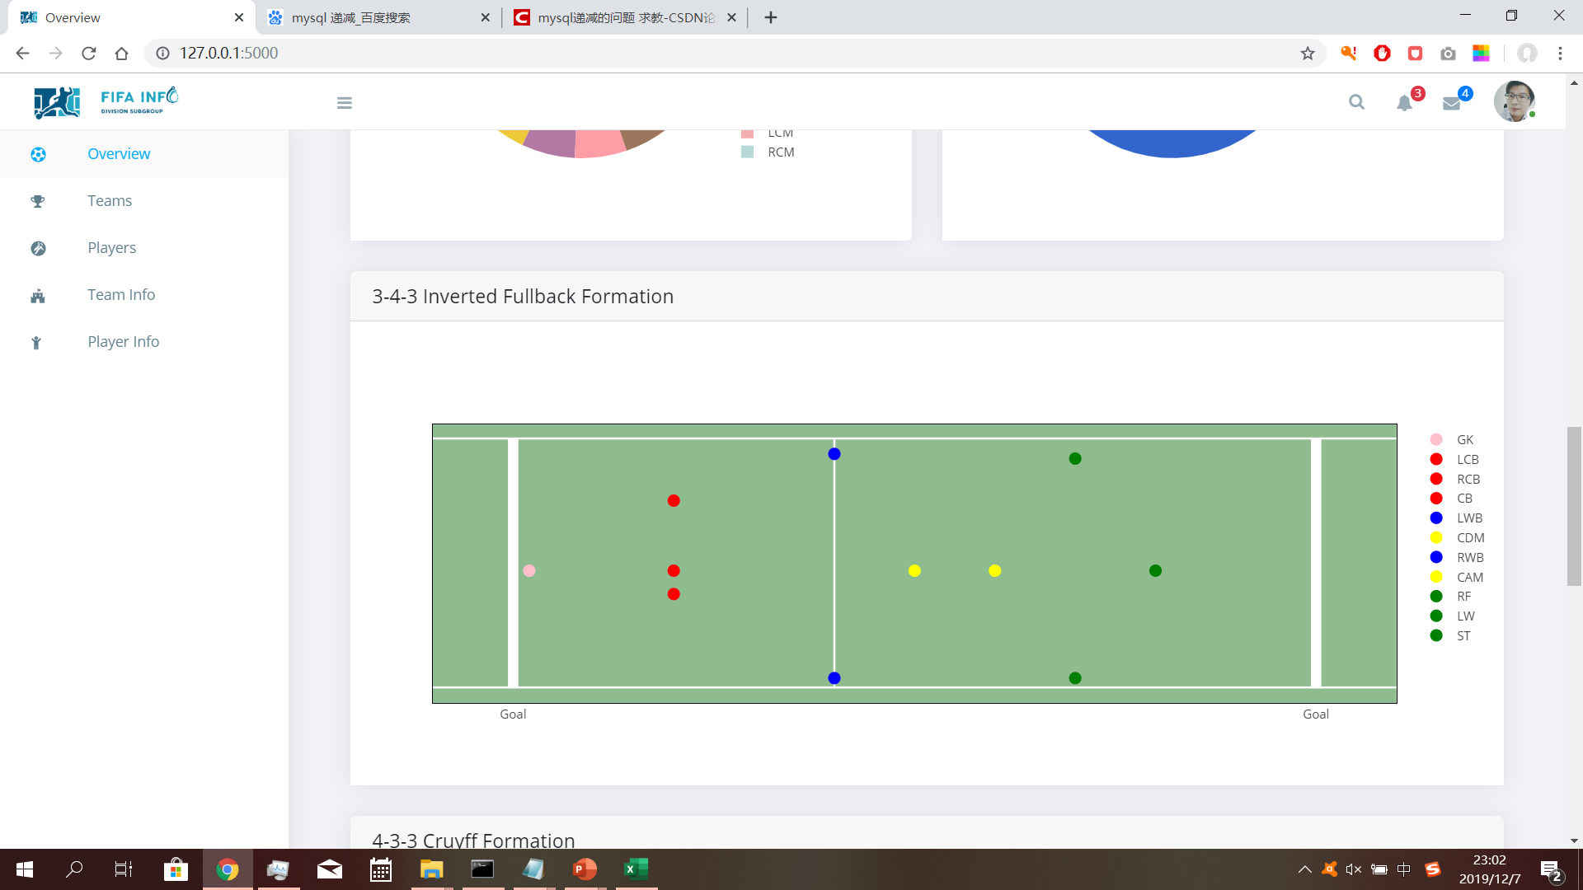
6 Statistics
World Map
Top Players
Percentages
Team Formation

Slide 8
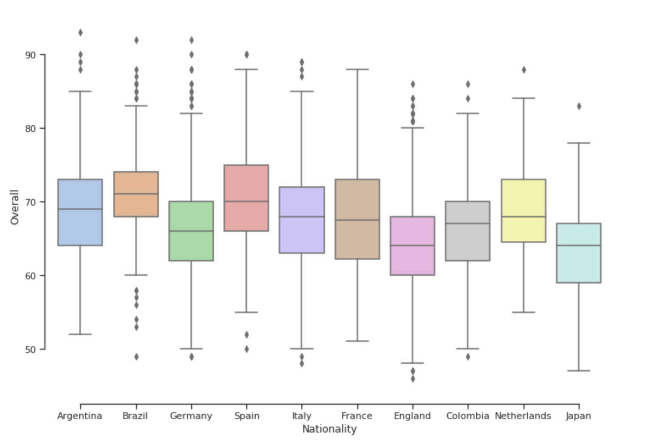
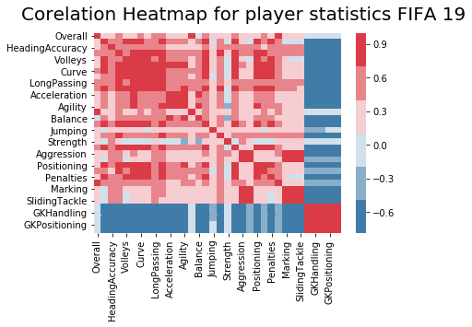
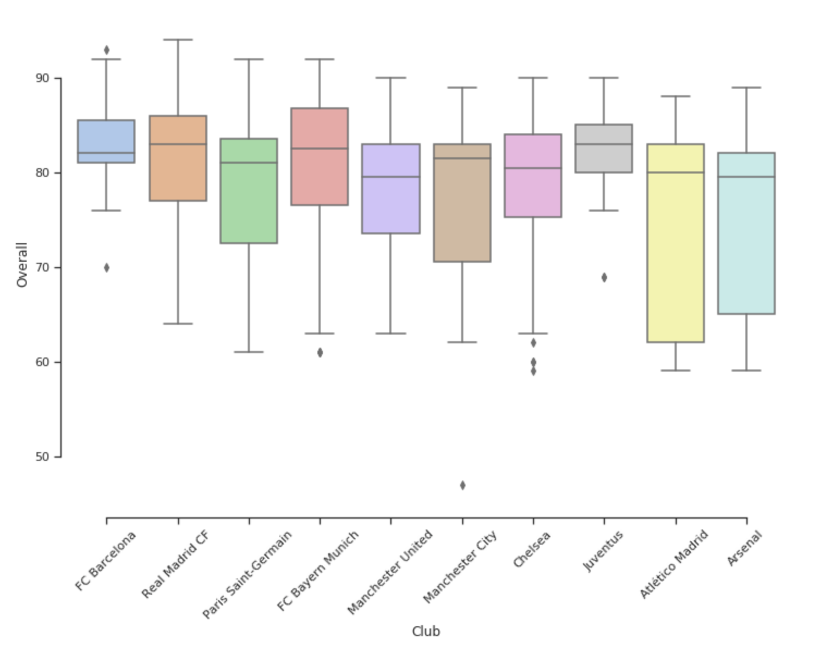
7 Data Mining
Box
Plots
Correlation Heatmap

Slide 9
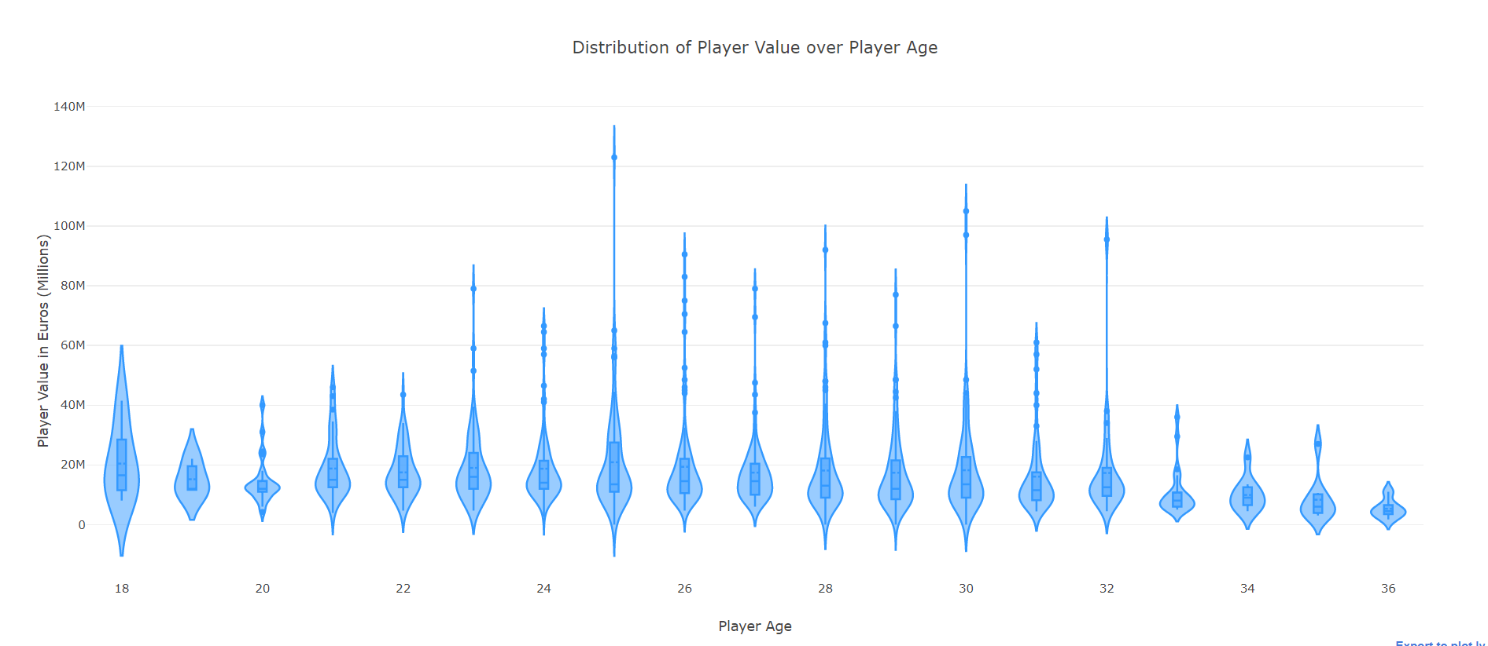
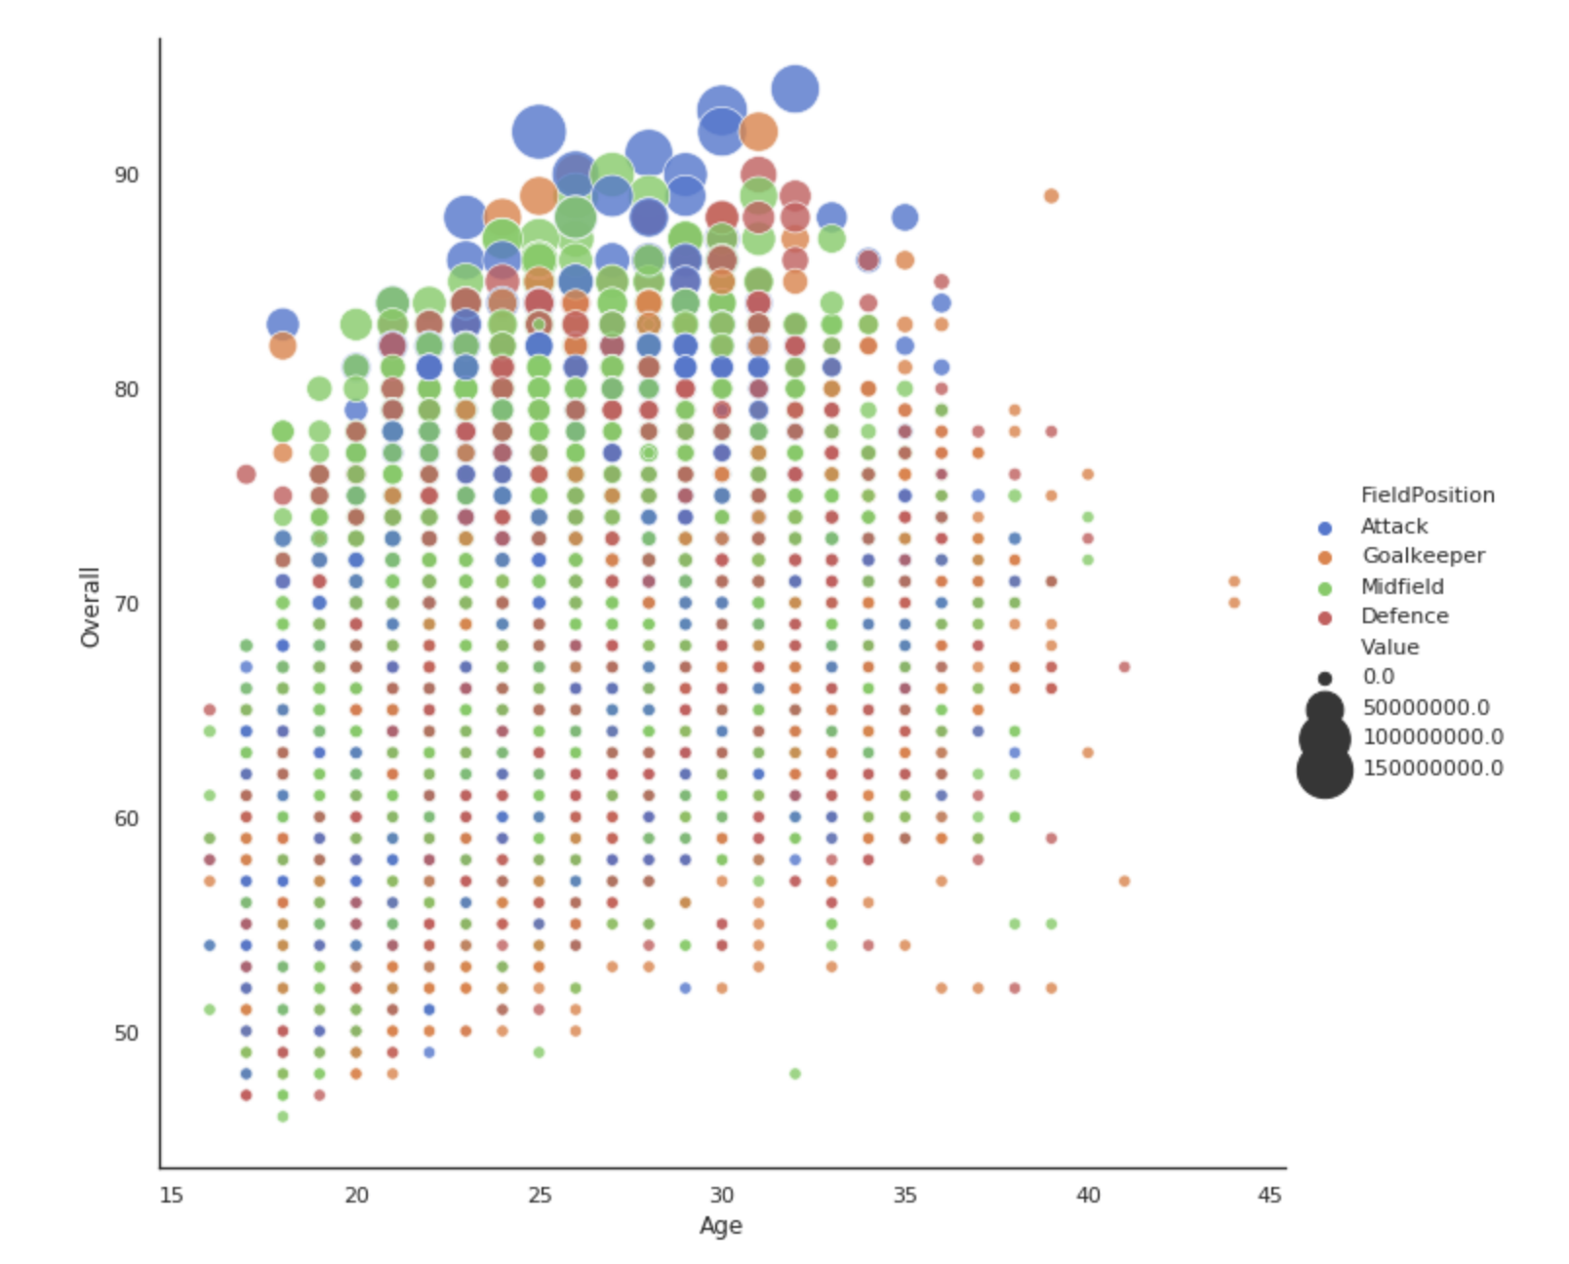
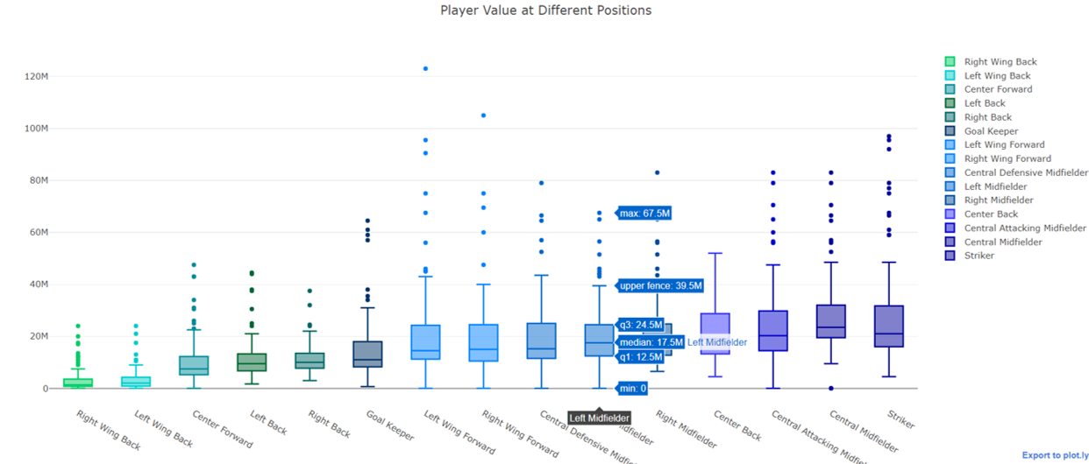
7 Data Mining
Distributions

Slide 10
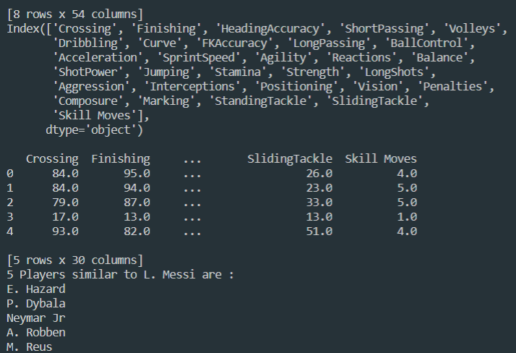
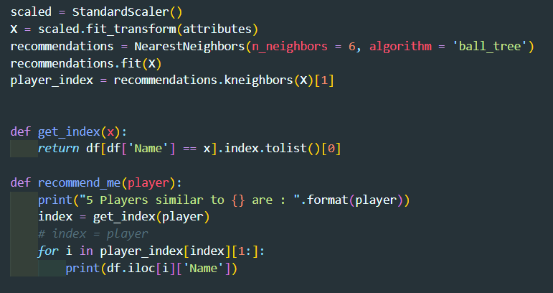
8 Machine Learning – Similar Players
KNN
Ball Tree Algorithm
A ball tree recursively divides the data into nodes defined by a centroid C and radius r, such that each point in the node lies within the hyper-sphere defined by r and C. The number of candidate points for a neighbor search is reduced through use of the triangle inequality:

Slide 11
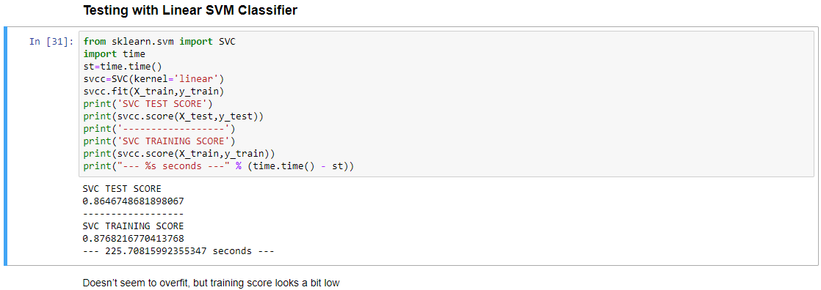
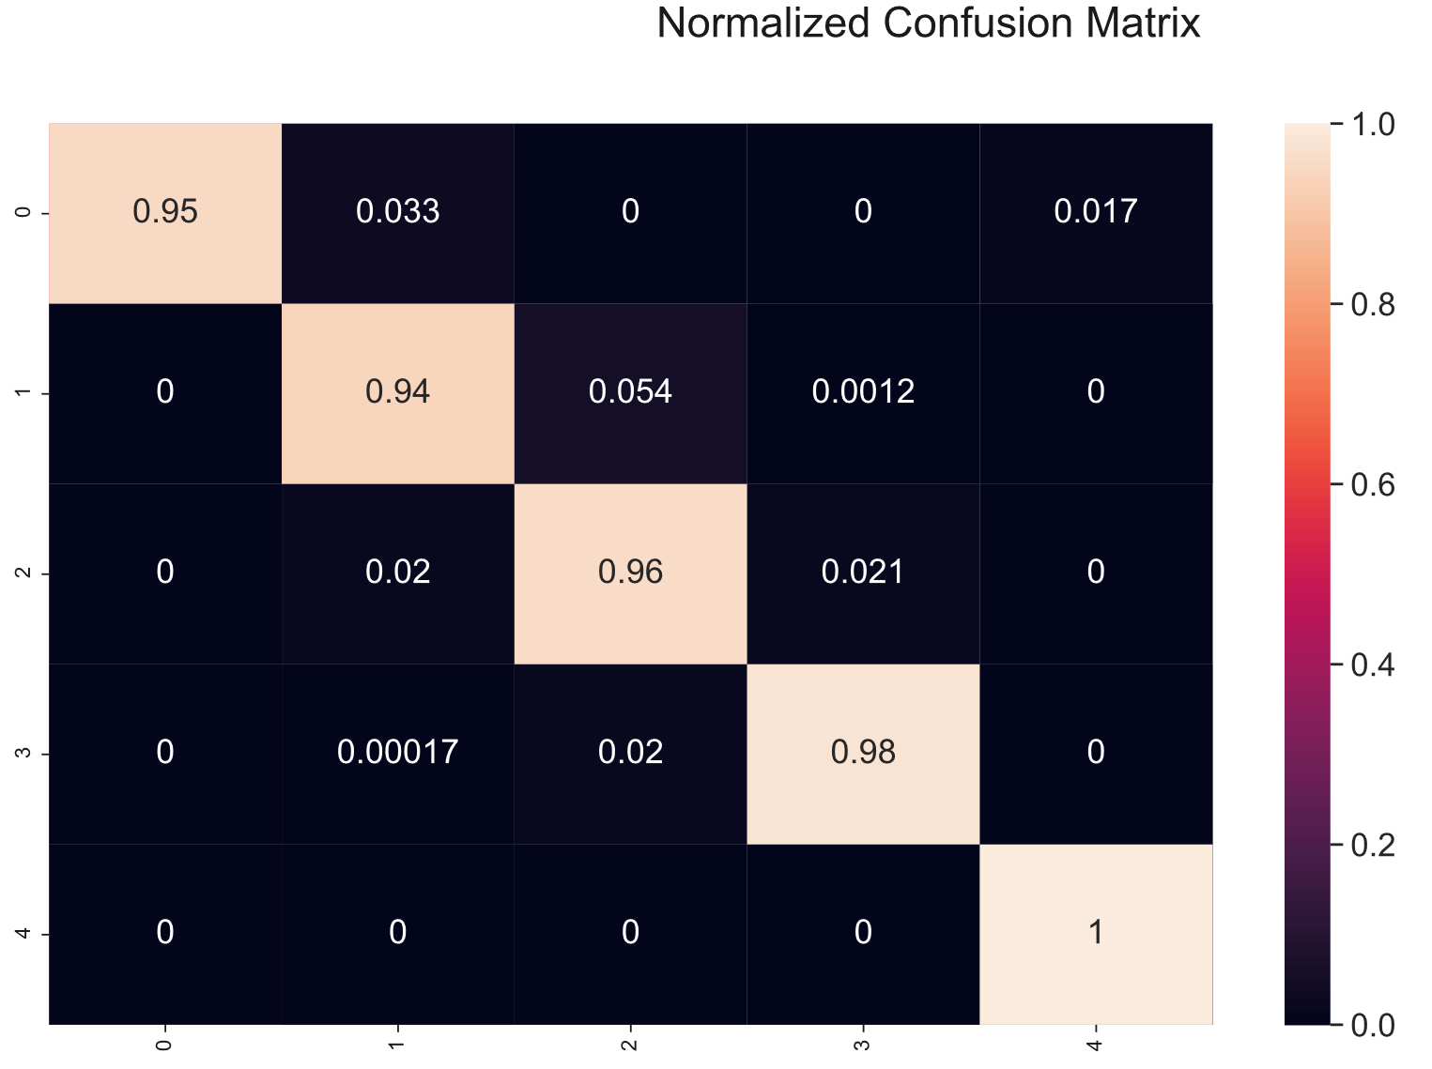
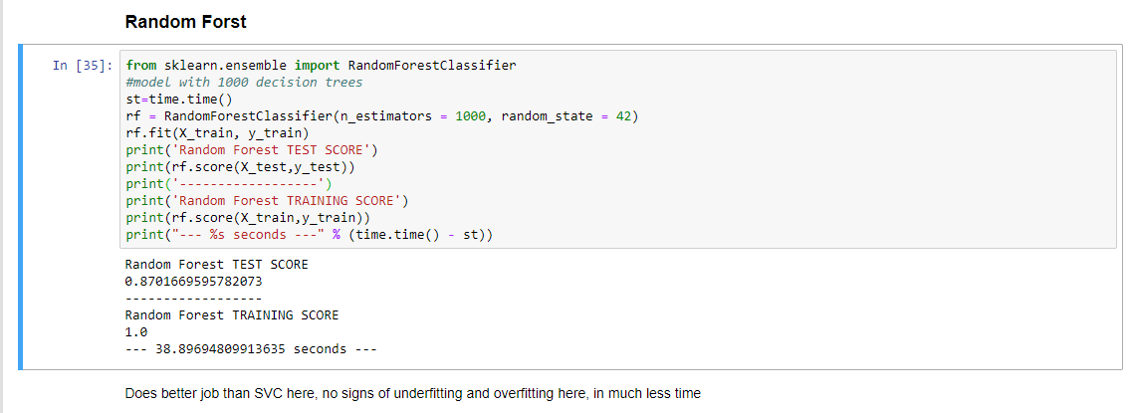
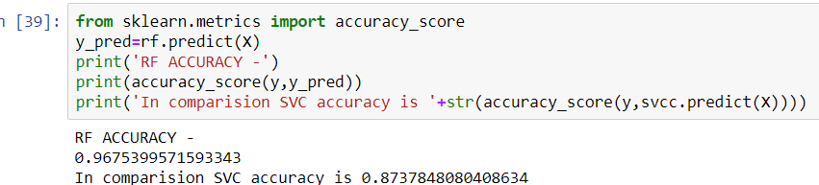
8 Machine Learning – Position Prediction
Linear SVM
We classify player positions into 5 categories:
Forward Player
Midfielder
Defense Player
Goalkeeper
Unclassified
Random Forest

Slide 12
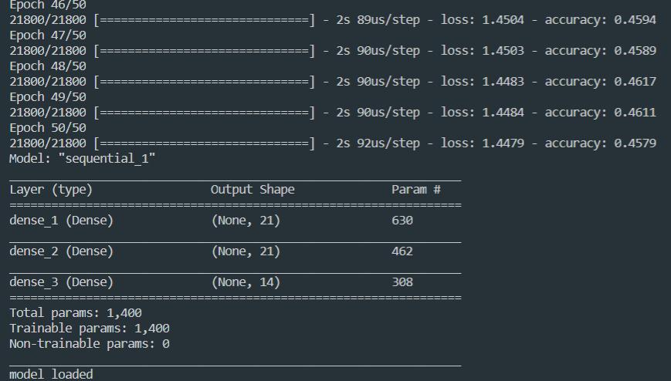
8 Machine Learning – Position Prediction
What If we do not classify into 5 categories…
(keep original 27 positions)
Artificial
Neural Network
(ANN)

Slide 13








9 Implementation & Results
Front End
Overview
Back End

Slide 14
DEMO

Slide 15
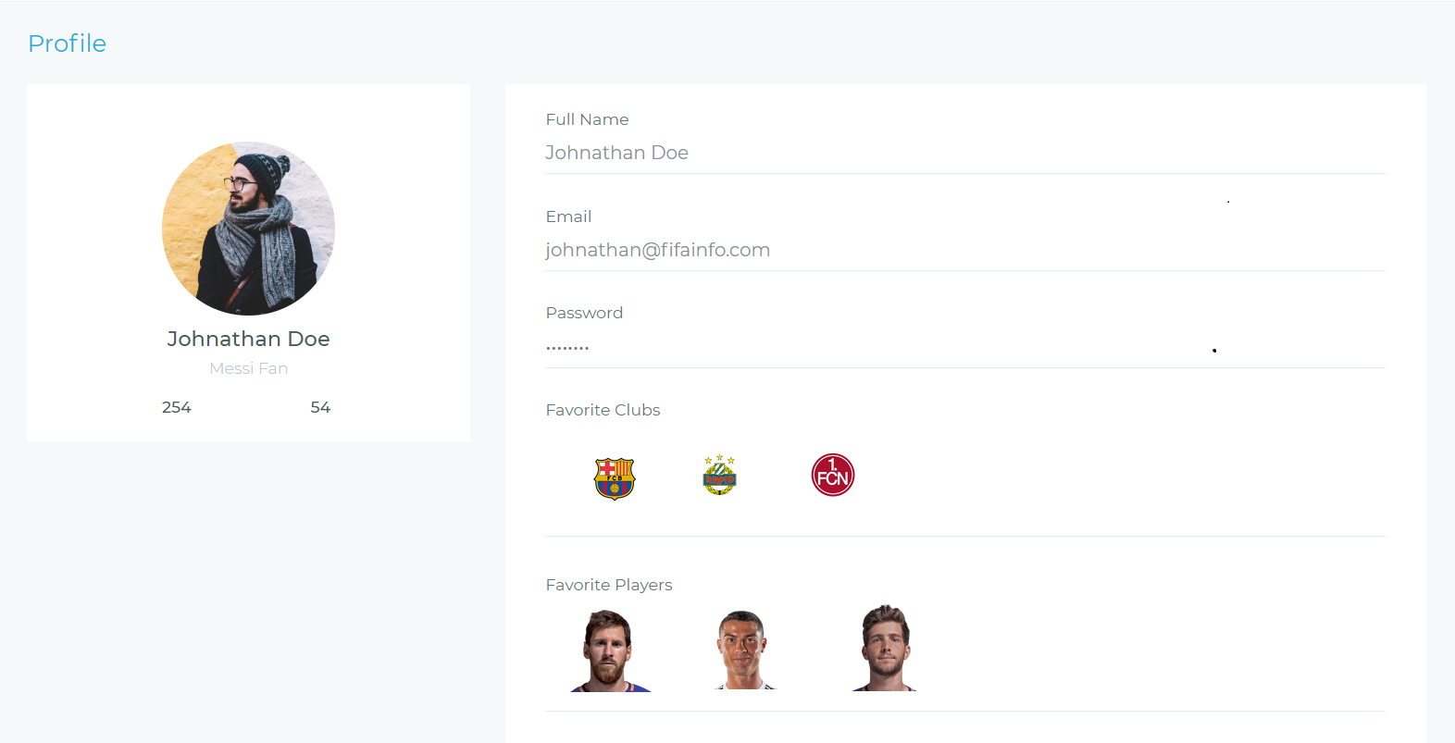
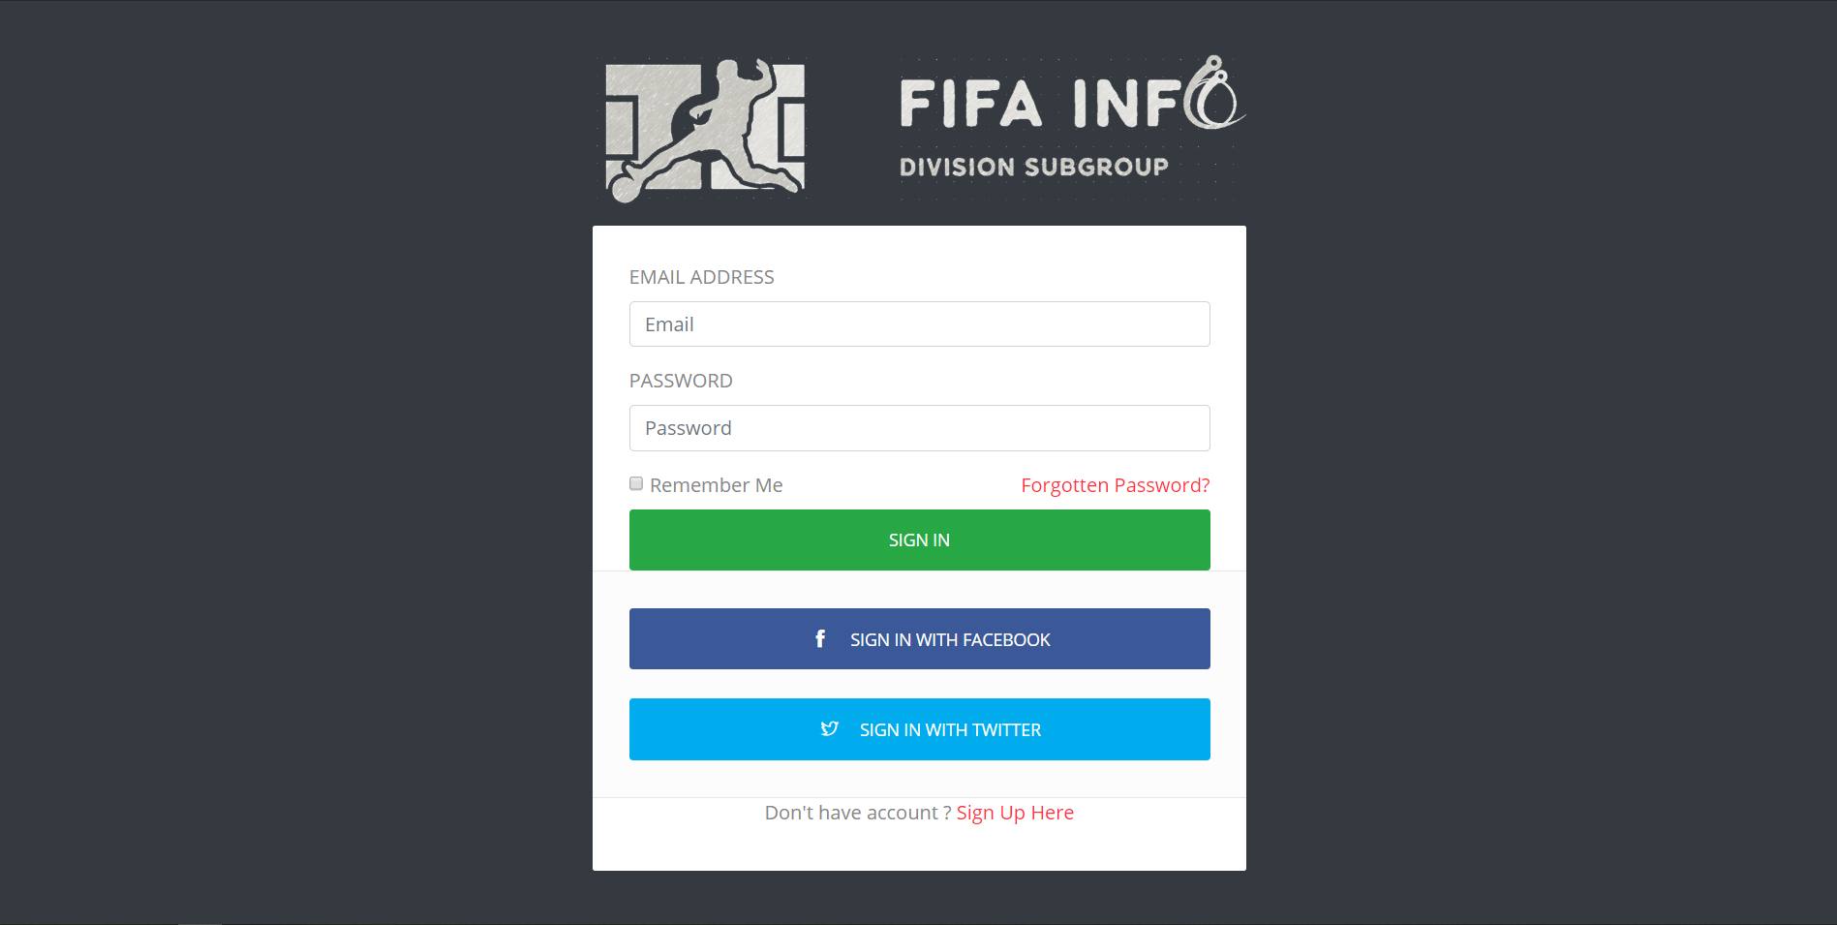
10 Prospects
User Page:
Sign up; Sign in; Profile
Favorites
Database Real-time Update

Slide 16
11 Readme
GitHub Repository: https://github.com/lanskyfan/fifaweb/tree/develop
Website Address: (Free access, anywhere in or out of campus)
http://106.54.207.45:5000/
(Due to cloud server unstable connection, the ‘overview’ page may load slowly while otherwise pages load normally.)
MySQL Connection: (For Prof. and TAs)
Hostname: 106.54.207.45 Port: 3306
Username: erg2 Password: 12345678

Slide 17
THANKS!

